Slide 1

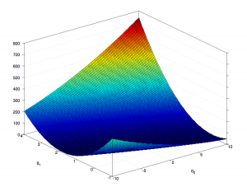
Training and Improving Neural Networks
How to train your neural network…
so that it doesn't explode
Yordan Darakchiev
Technical Trainer
iordan93@gmail.com

Slide 2
sli.do
#DeepLearning

Slide 3
Table of Contents
Regularization
Bias and variance
  Error analysis
Optimization algorithms
Hyperparameter tuning
Normalization

Slide 4
Bias and Variance
Machine learning practices
using big(ger) data

Slide 5
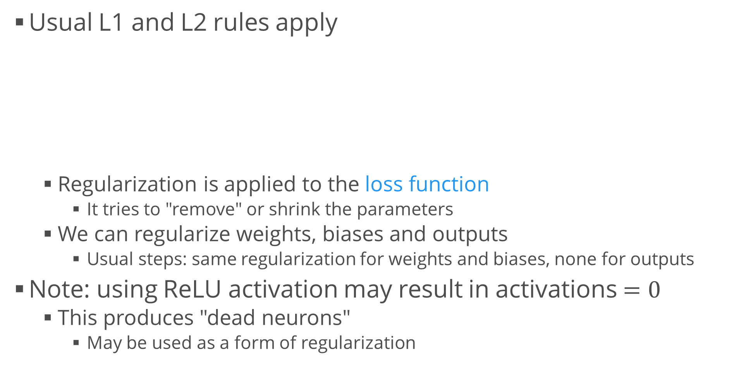
Regularization
Usual L1 and L2 rules apply
  Regularization is applied to the loss function
    It tries to "remove" or shrink the parameters
  We can regularize weights, biases and outputs
    Usual steps: same regularization for weights and biases, none for outputs
Note: using ReLU activation may result in activations $=0$
  This produces "dead neurons"
    May be used as a form of regularization
from tensorflow.layers import Dense
from tensorflow.keras import regularizers
Dense(
kernel_regularizer = regularizers.L1L2(l1 = 0.5, l2 = 1),
bias_regularizer = regularizers.L1L2(l1 = 0.5, l2 = 1),
activity_regularizer = regularizers.L1L2(l1 = 0.3, l2 = 10))

Slide 6
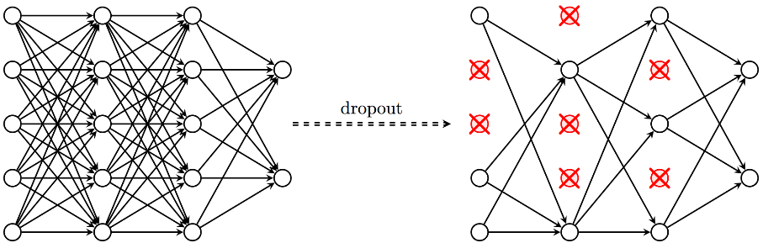
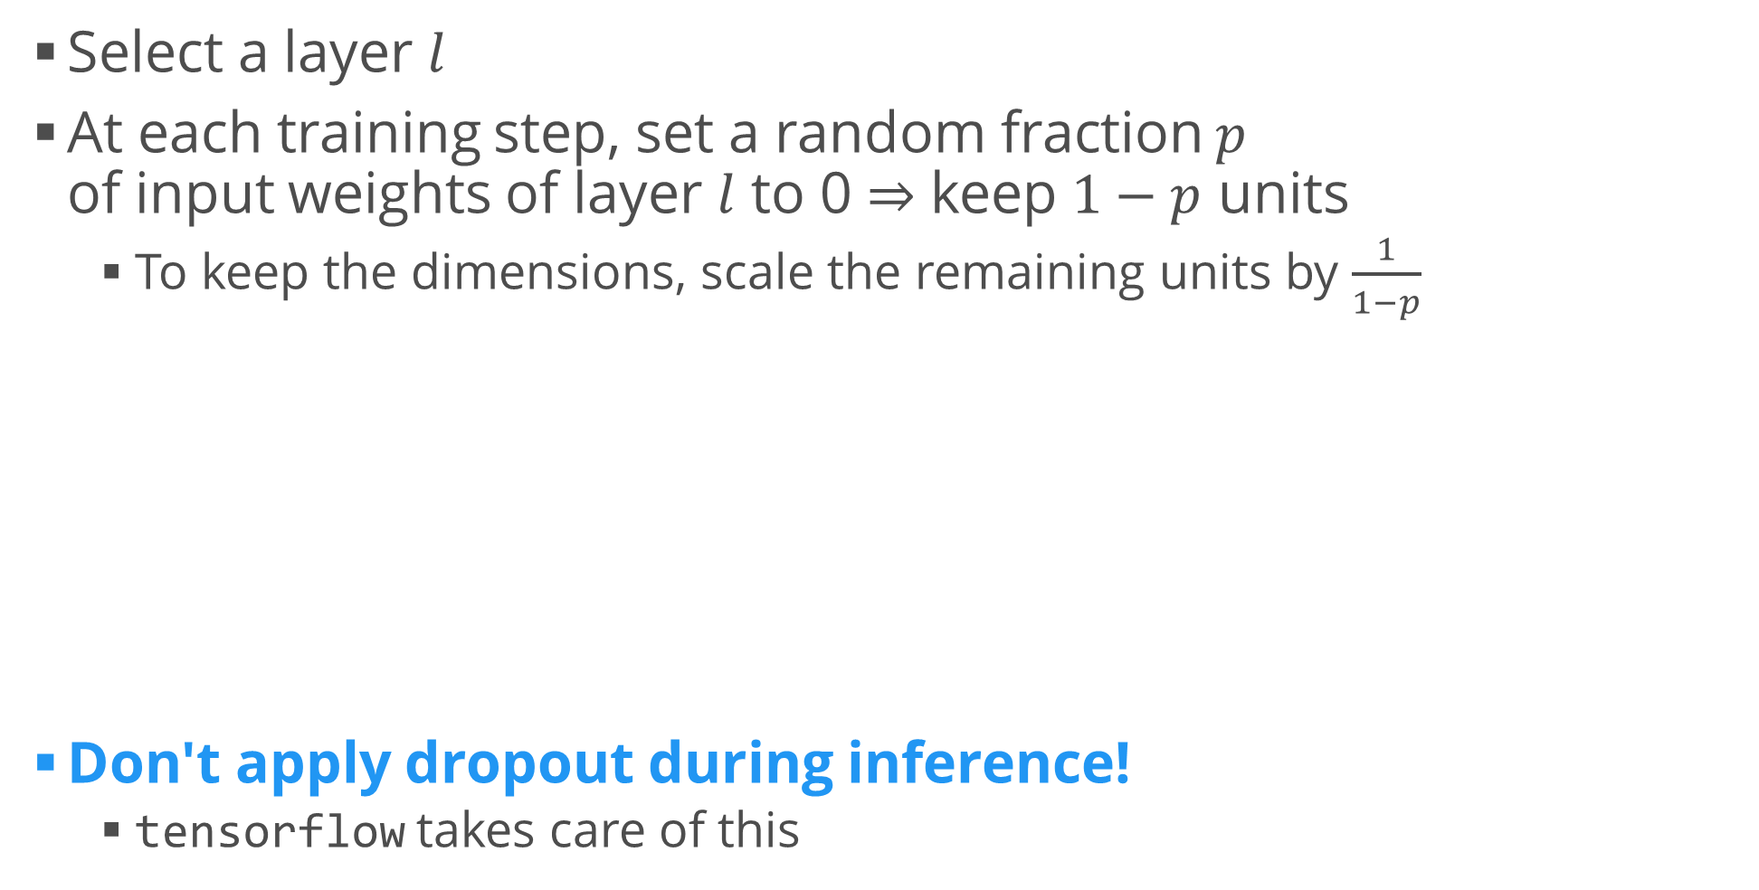
Dropout
Select a layer $l$
At each training step, set a random fraction $p$
of input weights of layer $l$ to 0 $⇒$ keep $1−p$ units
  To keep the dimensions, scale the remaining units by $\frac{1}{1−p}$
Don't apply dropout during inference!
  tensorflow takes care of this
from tensorflow.layers import Dropout
Dropout(0.1)

Slide 7
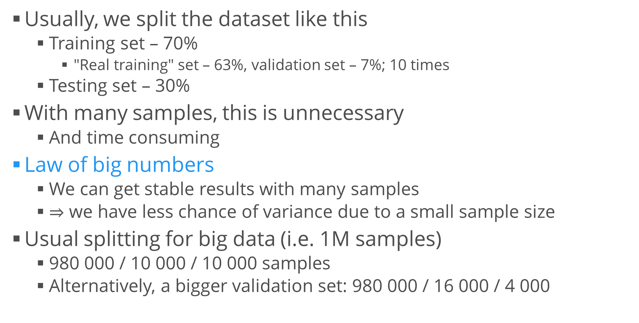
Selecting and Splitting Data
Usually, we split the dataset like this
  Training set – 70%
    "Real training" set – 63%, validation set – 7%; 10 times
  Testing set – 30%
With many samples, this is unnecessary
  And time consuming
Law of big numbers
  We can get stable results with many samples
  $⇒$ we have less chance of variance due to a small sample size
Usual splitting for big data (i.e. 1M samples)
  980 000 / 10 000 / 10 000 samples
  Alternatively, a bigger validation set: 980 000 / 16 000 / 4 000

Slide 8

Bias-Variance Error Analysis
Bayes optimal error: the "real" error in data
  No way to calculate, we need to try to come up with a measure
    Naïve: this is 0%, the dataset is perfect
Example: two-class classification (cats vs. dogs)
  Metric: misclassification error ($E=1−A$)
  Humans can achieve 0,5% error
Algorithm | Train set error | Validation set error | Bias, % | Variance, % | Verdict
A1 | 1% | 11% | 0,5% | 10% | High variance
A2 | 15% | 16% | 14,5% | 1% | High bias
A3 | 15% | 30% | 14,5% | 15% | Both
A4 | 0,5% | 1% | 0,5% | 0,5% | "Neither"
A5 | 0,3% | 0,4% | ? | ? | ?

Slide 9
Taking the Next Step
There are no set rules, only things we can try
High bias
  Train a bigger network
  Possibly, try out different architectures
    Try to find one which is best suited for the task
  Train longer (e.g. more epochs)
High variance
  Apply regularization
  Try a smaller network architecture
  Get more data
    Or try to augment the current dataset
      E.g. bootstrap sampling, image rotation, adding noise, etc.

Slide 10
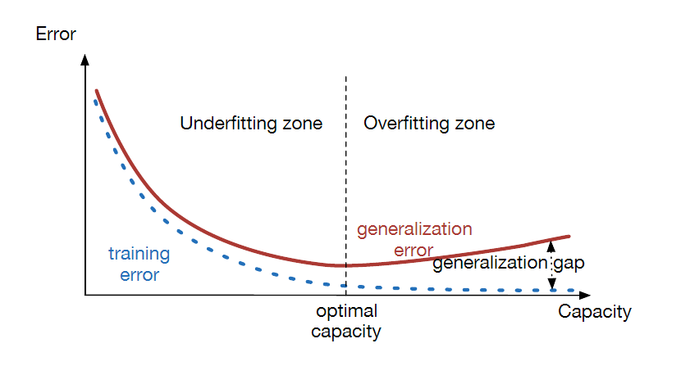
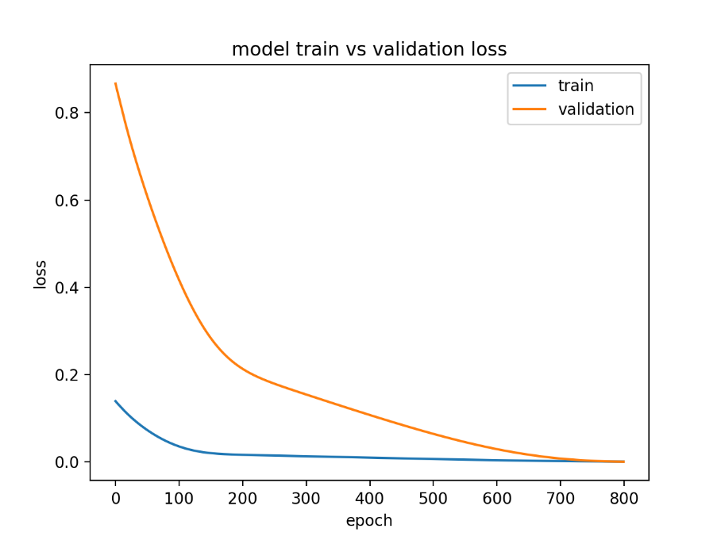
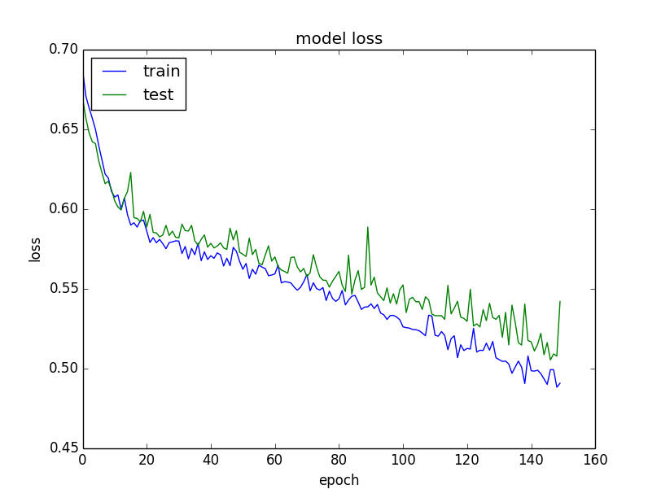
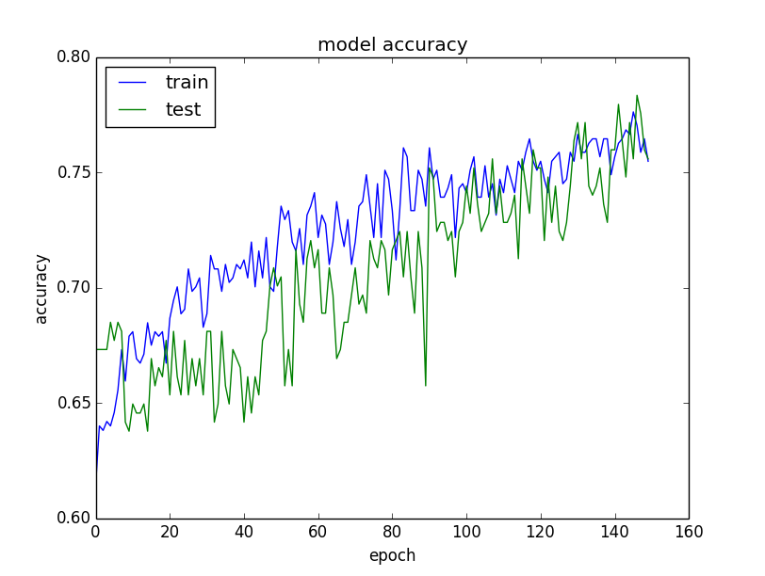
Training / Validation Curves
The same as what we already know
  Plot a metric (e.g. loss, accuracy…)
  w.r.t. the dataset size or epoch
The shape and relative position
of both curves help diagnose
under- / overfitting

Slide 11
Optimization
"Learn smarter, not harder"

Slide 12
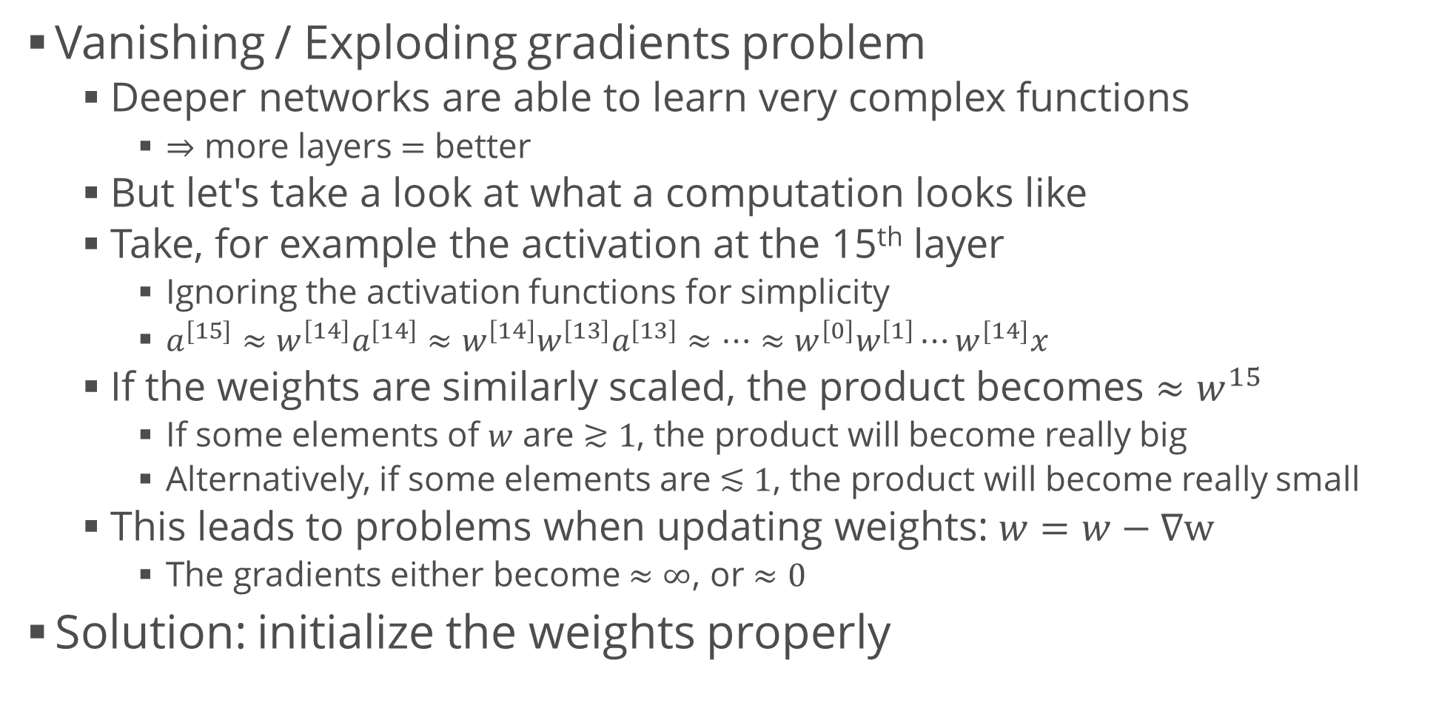
Weight Initialization
Vanishing / Exploding gradients problem
  Deeper networks are able to learn very complex functions
    $⇒$ more layers $=$ better
  But let's take a look at what a computation looks like
  Take, for example the activation at the 15th layer
    Ignoring the activation functions for simplicity
    $a^{[15]}≈w^{\left[14\right]}a^{\left[14\right]}≈w^{\left[14\right]}w^{\left[13\right]}a^{\left[13\right]}≈…≈w^{\left[0\right]}w^{\left[1\right]}⋯w^{[14]}x$
  If the weights are similarly scaled, the product becomes $≈w^{15}$
    If some elements of $w$ are $≳1$, the product will become really big
    Alternatively, if some elements are $≲1$, the product will become really small
  This leads to problems when updating weights: $w=w−∇w$
    The gradients either become $≈∞$, or $≈0$
Solution: initialize the weights properly

Slide 13
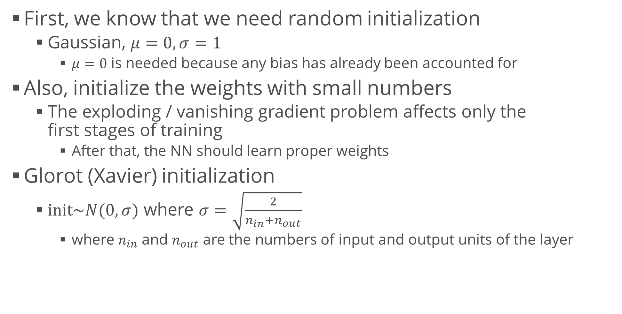
Weight Initialization (2)
First, we know that we need random initialization
  Gaussian, $μ=0, σ=1$
    $μ=0$ is needed because any bias has already been accounted for
Also, initialize the weights with small numbers
  The exploding / vanishing gradient problem affects only the
  first stages of training
    After that, the NN should learn proper weights
Glorot (Xavier) initialization
  $init\sim N(0, σ)$ where $σ=\sqrt{\frac{2}{n_{in}+n_{out}}}$
    where $n_{in}$ and $n_{out}$ are the numbers of input and output units of the layer
Dense(
kernel_initializer = tf.glorot_normal_initializer(), # or None
bias_initializer = tf.zeros_initializer())

Slide 14
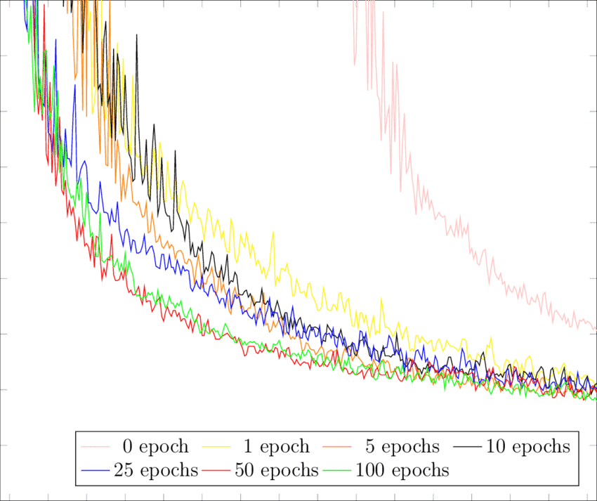
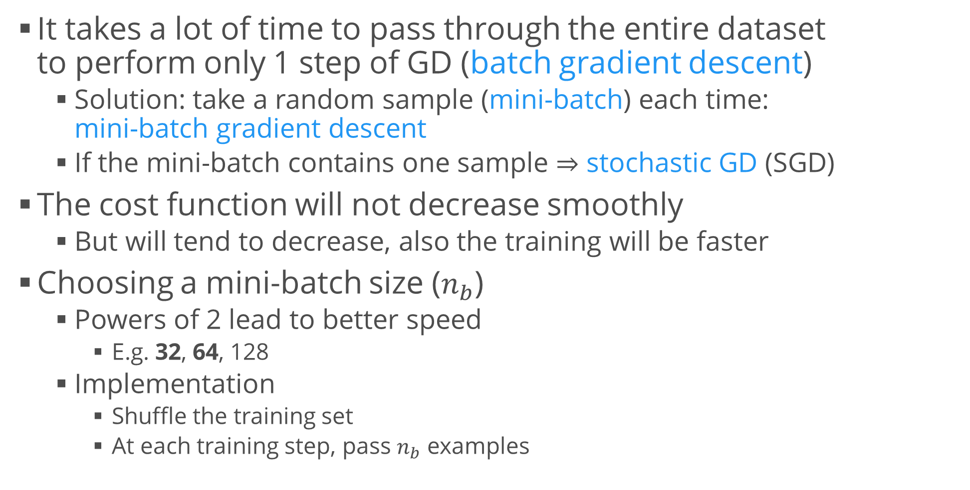
Mini-batch Gradient Descent
It takes a lot of time to pass through the entire dataset
to perform only 1 step of GD (batch gradient descent)
  Solution: take a random sample (mini-batch) each time:
  mini-batch gradient descent
  If the mini-batch contains one sample $⇒$ stochastic GD (SGD)
The cost function will not decrease smoothly
  But will tend to decrease, also the training will be faster
Choosing a mini-batch size ($n_{b}$)
  Powers of 2 lead to better speed
    E.g. 32, 64, 128
  Implementation
    Shuffle the training set
    At each training step, pass $n_{b}$ examples

Slide 15

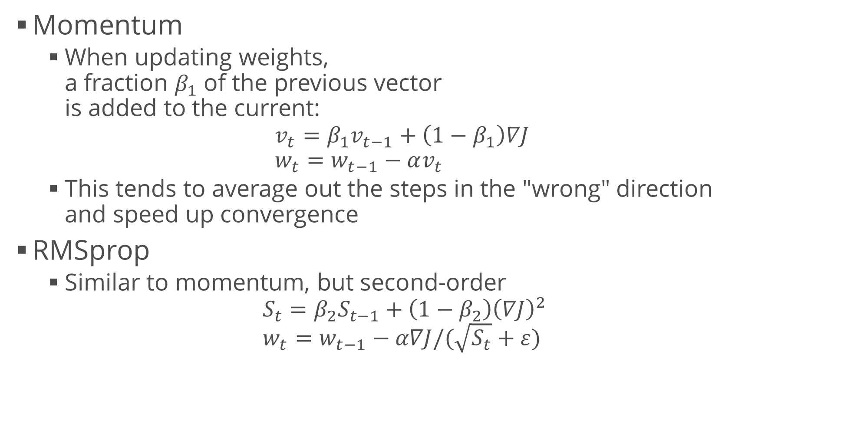
Improving Gradient Descent
Momentum
  When updating weights,
  a fraction $β_{1}$ of the previous vector
  is added to the current:
  $v_{t}=β_{1}v_{t−1}+\left(1−β_{1}\right)∇J$
  $w_{t}=w_{t−1}−αv_{t}$
  This tends to average out the steps in the "wrong" direction
  and speed up convergence
RMSprop
  Similar to momentum, but second-order
  $S_{t}=β_{2}S_{t−1}+\left(1−β_{2}\right){\left(∇J\right)}^{2}$
  $w_{t}=w_{t−1}−α∇J/(\sqrt{S_{t}}+ε)$

Slide 16
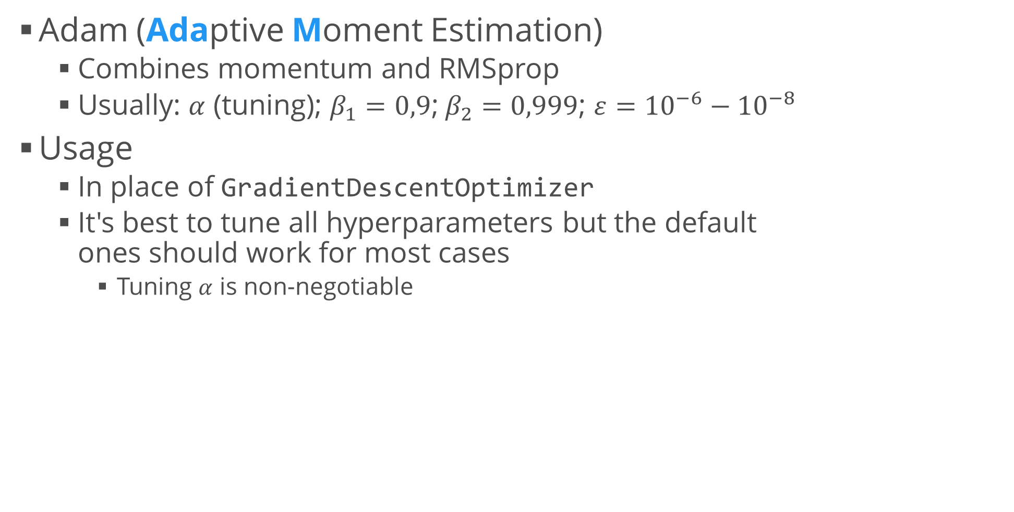
Adam Optimizer
Adam (Adaptive Moment Estimation)
  Combines momentum and RMSprop
  Usually: $α$ (tuning); $β_{1}=0,9$;$β_{2}=0,999$; $ε={10}^{−6}−{10}^{−8}$
Usage
  In place of GradientDescentOptimizer
  It's best to tune all hyperparameters but the default
  ones should work for most cases
    Tuning $α$ is non-negotiable
tf.train.AdamOptimizer(
learning_rate = 0.001,
beta1 = 0.9,
beta2 = 0.999,
epsilon = 1e-8)

Slide 17
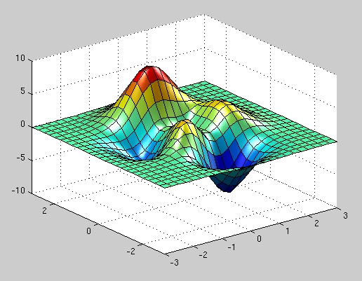
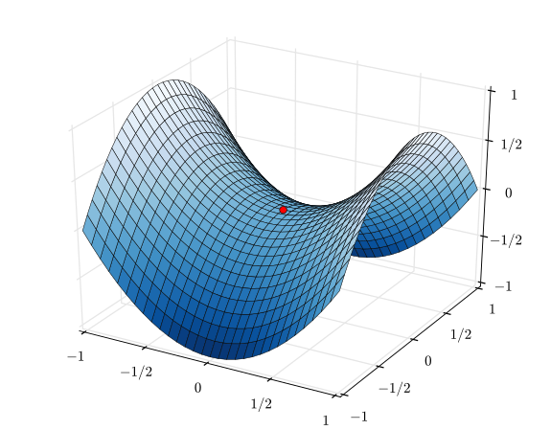
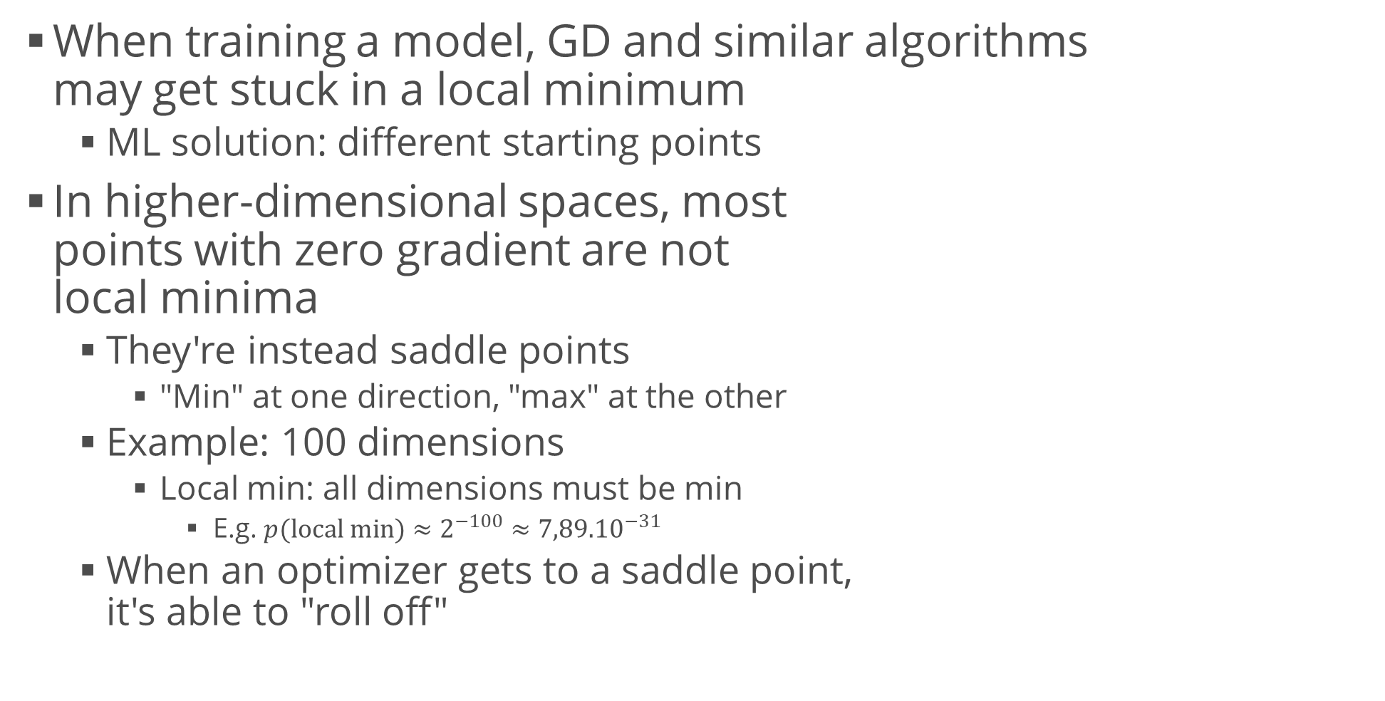
A Note on Local Minima
When training a model, GD and similar algorithms
may get stuck in a local minimum
  ML solution: different starting points
In higher-dimensional spaces, most
points with zero gradient are not
local minima
  They're instead saddle points
    "Min" at one direction, "max" at the other
  Example: 100 dimensions
    Local min: all dimensions must be min
      E.g. $p(local min)≈2^{−100}≈{7,89.10}^{−31}$
  When an optimizer gets to a saddle point,
  it's able to "roll off"

Slide 18
Hyperparameter Tuning
Similar to "standard"
machine learning

Slide 19
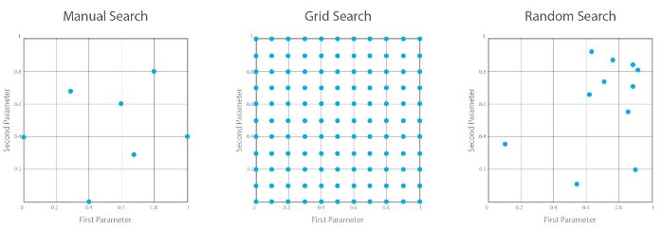
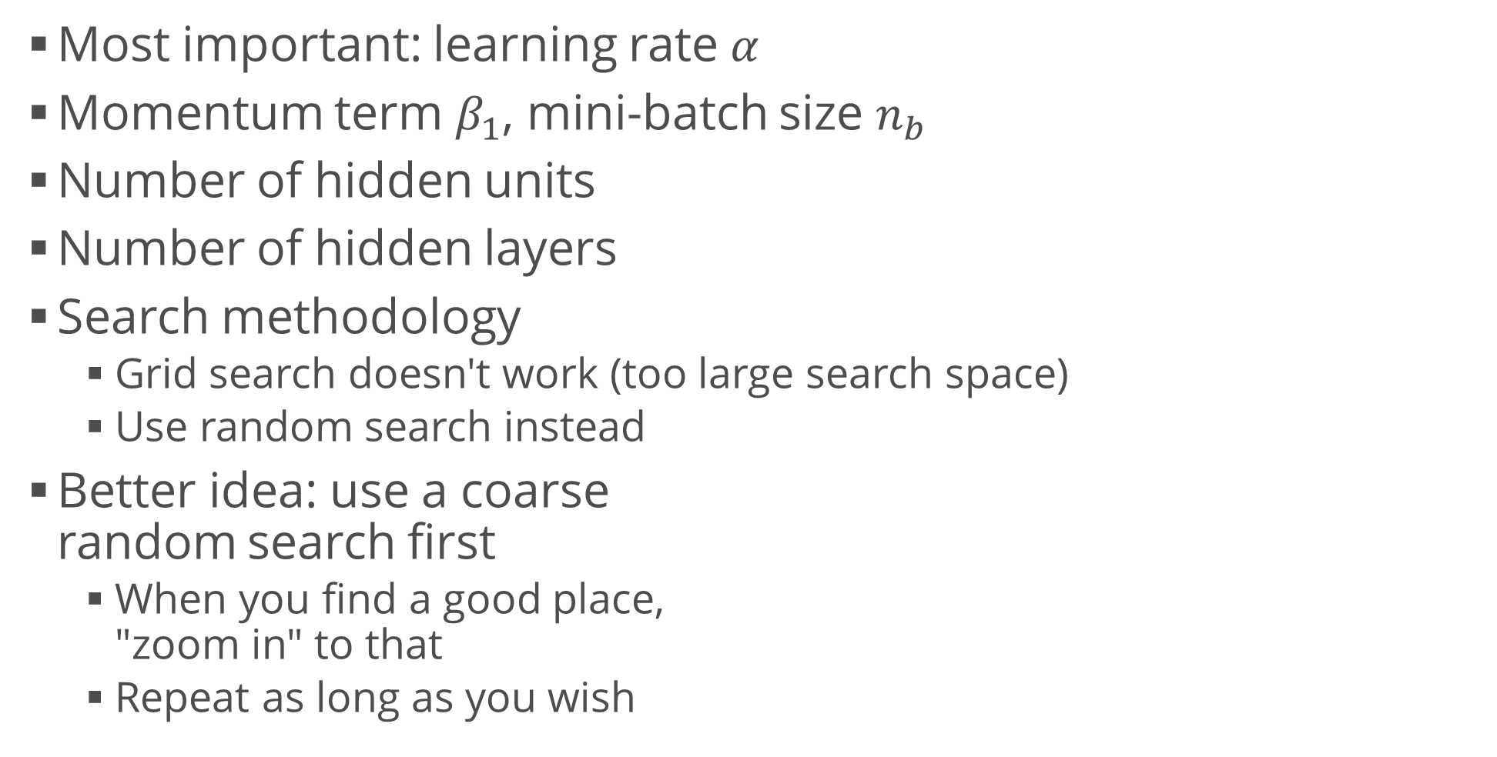
Prioritizing Hyperparameters
Most important: learning rate $α$
Momentum term $β_{1}$, mini-batch size $n_{b}$
Number of hidden units
Number of hidden layers
Search methodology
  Grid search doesn't work (too large search space)
  Use random search instead
Better idea: use a coarse
random search first
  When you find a good place,
  "zoom in" to that
  Repeat as long as you wish

Slide 20
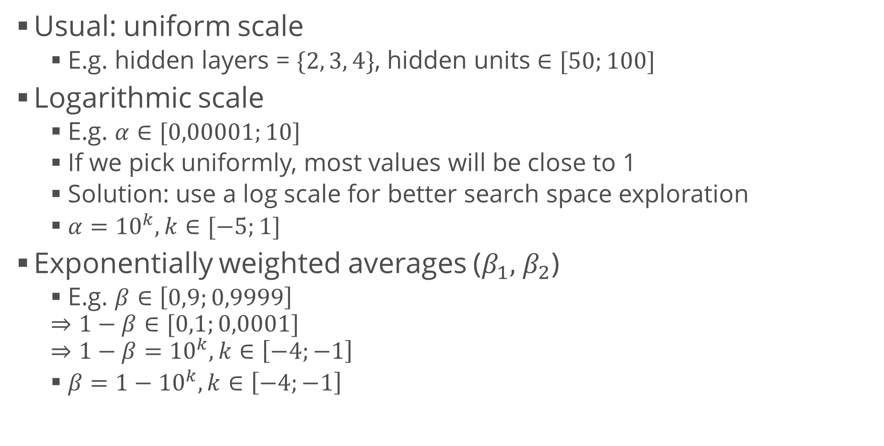
Hyperparameter Scales
Usual: uniform scale
  E.g. hidden layers = $\{2, 3, 4\}$, hidden units $∈[50;100]$
Logarithmic scale
  E.g. $α∈[0,00001;10]$
  If we pick uniformly, most values will be close to 1
  Solution: use a log scale for better search space exploration
  $α={10}^{k},k∈[−5;1]$
Exponentially weighted averages ($β_{1},$ $β_{2}$)
  E.g. $β∈\left[0,9;0,9999\right]$
  $$⇒1−β∈[0,1;0,0001]$$
  $$⇒1−β={10}^{k}, k∈\left[−4;−1\right]$$
  $β=1−{10}^{k}, k∈\left[−4;−1\right]$

Slide 21
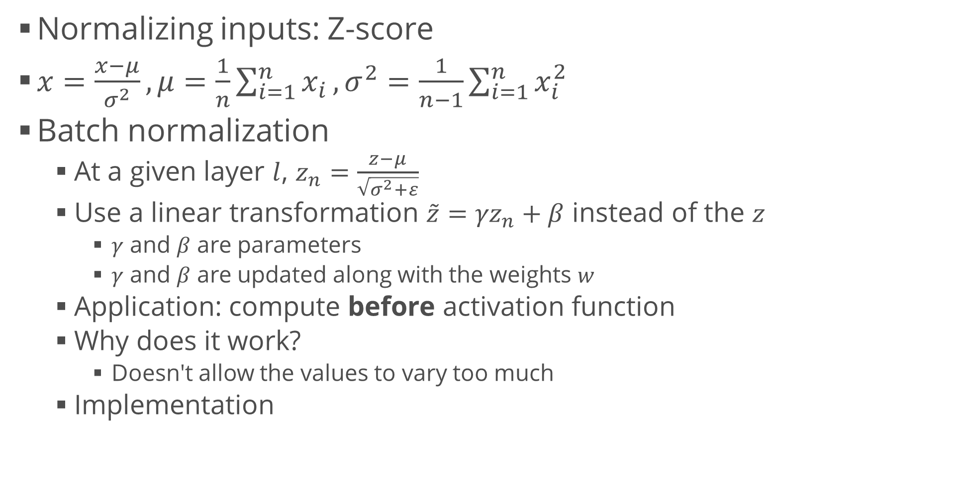
Batch Normalization
Normalizing inputs: Z-score
$x=\frac{x−μ}{σ^{2}}, μ=\frac{1}{n}\sum_{i=1}^{n}{x_{i}},σ^{2}=\frac{1}{n−1}\sum_{i=1}^{n}{x_{i}^{2}}$
Batch normalization
  At a given layer $l$, $z_{n}=\frac{z−μ}{\sqrt{σ^{2}+ε}}$
  Use a linear transformation $\tilde{z}={γz}_{n}+β$ instead of the $z$
    $γ$ and $β$ are parameters
    $γ$ and $β$ are updated along with the weights $w$
  Application: compute before activation function
  Why does it work?
    Doesn't allow the values to vary too much
  Implementation
from tensorflow.keras.layers import BatchNormalization
BatchNormalization(input)

Slide 22
Summary
Regularization
Bias and variance
  Error analysis
Optimization algorithms
Hyperparameter tuning
Normalization

